Slide 1
Machine Learning on Azure

Slide 2
Time |  | Agenda
09:30 AM | 10:00 AM | Azure Machine Learning Overview
10:00 AM | 10:45 AM | Interactive exploration of an existing solution
10:45 AM | 11:00 AM | Break
11:00 AM | 12:00 PM | ML Studio Hands on Lab
12:00 PM | 01:00 PM | Lunch and use case and discussion
01:00 PM | 01:30 PM | Q & A

Slide 3
Option 2: Detailed intro
Microsoft AI Platform
Azure AI Services
PRE-BUILT AI
CONVERSATIONAL AI
CUSTOM AI
CODING & MANAGEMENT TOOLS
Cognitive Services
Tools
Bot Service
Azure Machine Learning
VS Tools for AI
Azure ML Studio
Azure ML Workbench
Others (PyCharm, Jupyter Notebooks…)
Azure Infrastructure
DEEP LEARNING FRAMEWORKS
AI ON DATA
AI COMPUTE
3rd Party
Cosmos DB
SQL
DB
SQL
DW
Data Lake
Spark
DSVM
Batch AI
ACS
IoT Edge
Cognitive Toolkit
TensorFlow
Caffe
CPU, FPGA, GPU
Others (Scikit-learn, MXNet, Keras, Chainer, Gluon…)
Notes:
Let’s start with AI services. We provide the most comprehensive set of AI services for any developer, any organization, and any scenario.
We have pre-built AI services with Cognitive Services. We were the first ones in the market to release this concept of AI as a service, and we are leaders in terms of developer adoption, number of services and capabilities provided. We have the unique capability for developers to customize these services for any particular scenario, something our competitors are only in the very early stages of.
We also have the most powerful bot platform, fully integrated with these services, enabling organizations to embrace conversational AI and connect them with their business processes.
And finally, we also provide a full solution for custom AI with Azure Machine Learning, covering the entire lifecycle of AI development in the Enterprise, from training to deployment.
All of this is based on the powerful infrastructure provided by Azure. We are taking all that power and applying it to AI, from CPU compute to GPU and next, FPGA.
We have a huge lever in the market with our tools. We’re taking the power of Visual Studio and Visual Studio Code to AI development. We are unique in our ability to provide a full solution across services and tools to make AI development productive and approachable.
Every developer can be an AI developer with this unique combination.
Lastly, we take an open approach to this solution. These tools and services work across any framework, we don’t make the decision for you, so you are not locked in to a vendor.

Slide 4

Azure AI services
Bot Service
Spider
Accelerated development for conversational AI.
Cognitive Services
Vision, speech, language, knowledge and search pre-trained services customizable for any scenario.
Azure Machine Learning
Experimentation and management services for creating AI models with productivity.
Notes:
We have the most powerful bot platform combined with customizable Cog Services. Enterprises can easily build powerful agents to streamline work processes and integrate in their existing data estate – whether on premises, edge, cloud or hybrid. AML enables enterprises to further customize their solutions based on their unique needs. We were the first organization to surpass human parity for both vision and speech.

Slide 5
Azure Bot Service
Bot builder
Platform
Intelligence
SDK updates
Speech support
Improved dialog tools
Debugging improvements
Channel inspector
Improved tooling
New channels
Cortana
Bing
Skype for Business
Adaptive cards
Speech support
Payments
Analytics
Bot controls
Speech support
Cognitive services

Slide 6







Microsoft Cognitive Services
Vision
Speech
Language
Knowledge
Search
Labs
Computer Vision
Content Moderator
Emotion
Face
Video Indexer
Bing Speech
Speaker Recognition
Bing Spell Check
Linguistic Analysis
Text Analytics
Translator Text & Speech
Web Language Model
Academic Knowledge
Entity Linking
Knowledge Exploration
Recommendations
QnA Maker
Bing Autosuggest
Bing Image Search
Bing News Search
Bing Video Search
Bing Web Search
Bing Entity Search
Project Prague (gesture)
Project Cuzco (events)
Project Johannesburg (routing)
Project Nanjing (isochrones)
Project Abu Dhabi (distance matrix)
Project Wollongong (location)
CUSTOMIZATION
Custom Vision Service
Custom Speech Service
Language Understanding
Custom Decision Service
Bing Custom Search

Slide 7

Azure Machine Learning - Experimentation
Local machine
Scale up to DSVM
Command line tools
Scale out with Spark on HDInsight
IDEs
Notebooks in Workbench
AZURE ML
EXPERIMENTATION
VS Code Tools for AI
Azure Batch AI (Coming Soon)
ML Server
Notes:
Start with the set of tools you want to use: command line, editors, notebooks, VS Tools for AI
Connect to Experimentation service, connects to various compute contexts
Docker container based deployment allows:
Single node deployment (cloud/on prem)
Clustered deployments via Azure Container Service
public preview target of 10k RPS on ACS cluster configuration
Currently have published models (via TLC) with <10ms latency
Edge deployment via Azure IOT Edge
Microsoft ML Server on-premises
Other deployment options
Spark clusters
Data engines:
SQL
CosmosDB (roadmap)
U-SQL (roadmap)
FPGAs (roadmap)
Serverless (roadmap)
Docker logo
Single node (on prem, cloud
ACS
Edge
MSFT ML Services
Spark cluster
SQL
Use slide 8 as reference
List

Slide 8
Azure Machine Learning – Model Management
Single node deployment (cloud/on-prem)
Azure Container Service
Azure IoT Edge
AZURE ML
MODEL MANAGEMENT
DOCKER
Microsoft ML Server
Spark clusters
SQL Server
Notes:
Take what built and wrap it up in a Docker container. Feed back metrics of model and give tools to manage model.
Meets diverse needs: Maybe 10,000 models deployed that are called infrequently, or 1 model replicated on 1,000 cores because everything uses that model
You get control on where and how want to deploy model
Docker container based deployment allows:
Single node deployment (cloud/on prem)
Clustered deployments via Azure Container Service
public preview target of 10k RPS on ACS cluster configuration
Currently have published models (via TLC) with <10ms latency
Edge deployment via Azure IOT Edge
Microsoft ML Server on-premises
Other deployment options
Spark clusters
Data engines:
SQL
CosmosDB (roadmap)
U-SQL (roadmap)
FPGAs (roadmap)
Serverless (roadmap)
Docker logo
Single node (on prem, cloud
ACS
Edge
MSFT ML Services
Spark cluster
SQL
Use slide 8 as reference
List

Slide 9
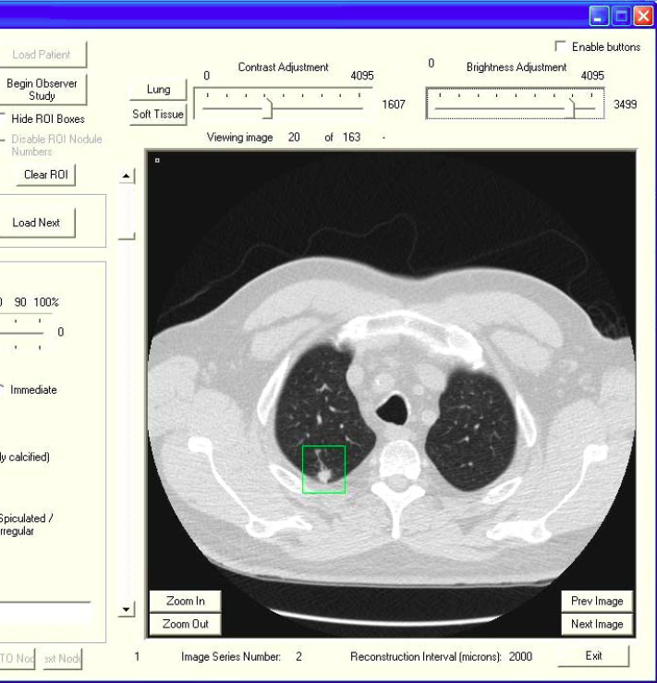
AI infrastructure
AI on data
Built-in AI across your data estate.
AI compute
Flexible compute infrastructure from virtually infinite cloud scale to the edge .
AI core infrastructure
The AI supercomputer: CPU, GPU, and (coming next) FPGA.
Notes:
Our second area of differentiation is our comprehensive data platform. There’s no AI without data, and only Microsoft can bring AI to wherever the data is – on premises, on the edge, in the cloud and everywhere in between.
All of this is based on the powerful infrastructure provided by Azure. We are taking all that power and applying it to AI, from CPU compute to GPU and next, FPGA.

Slide 10
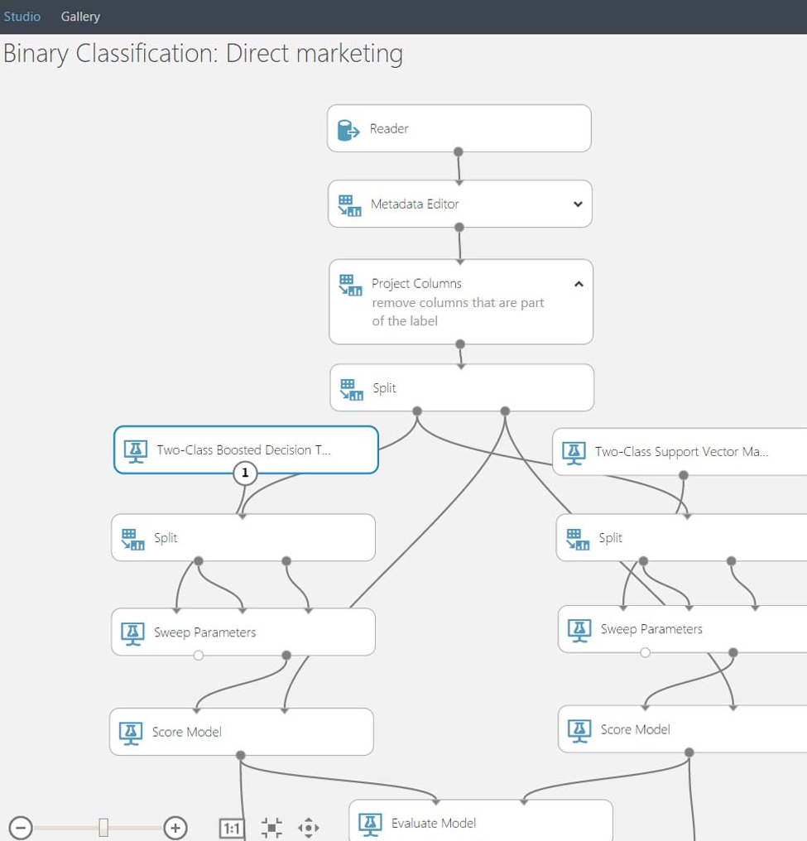
Tools
Visual Studio Tools for AI
Boost productivity with code-centric AI development and Azure integration.
Azure Machine Learning Workbench
Full lifecycle support for AI and data wrangling productivity.
Azure Machine Learning Studio
Drag and drop machine learning development for any skillset.
Open deep learning framework support
Full support for Cognitive Toolkit, TensorFlow, Caffee and others.
Open standard for deep learning (ONNX).
Notes:
The same is true for Tools. We have a huge lever in the market with our tools. We’re taking the power of Visual Studio and Visual Studio Code to AI development. No other vendor provides a full solution across services and tools to make AI development productive and approachable.

Slide 11
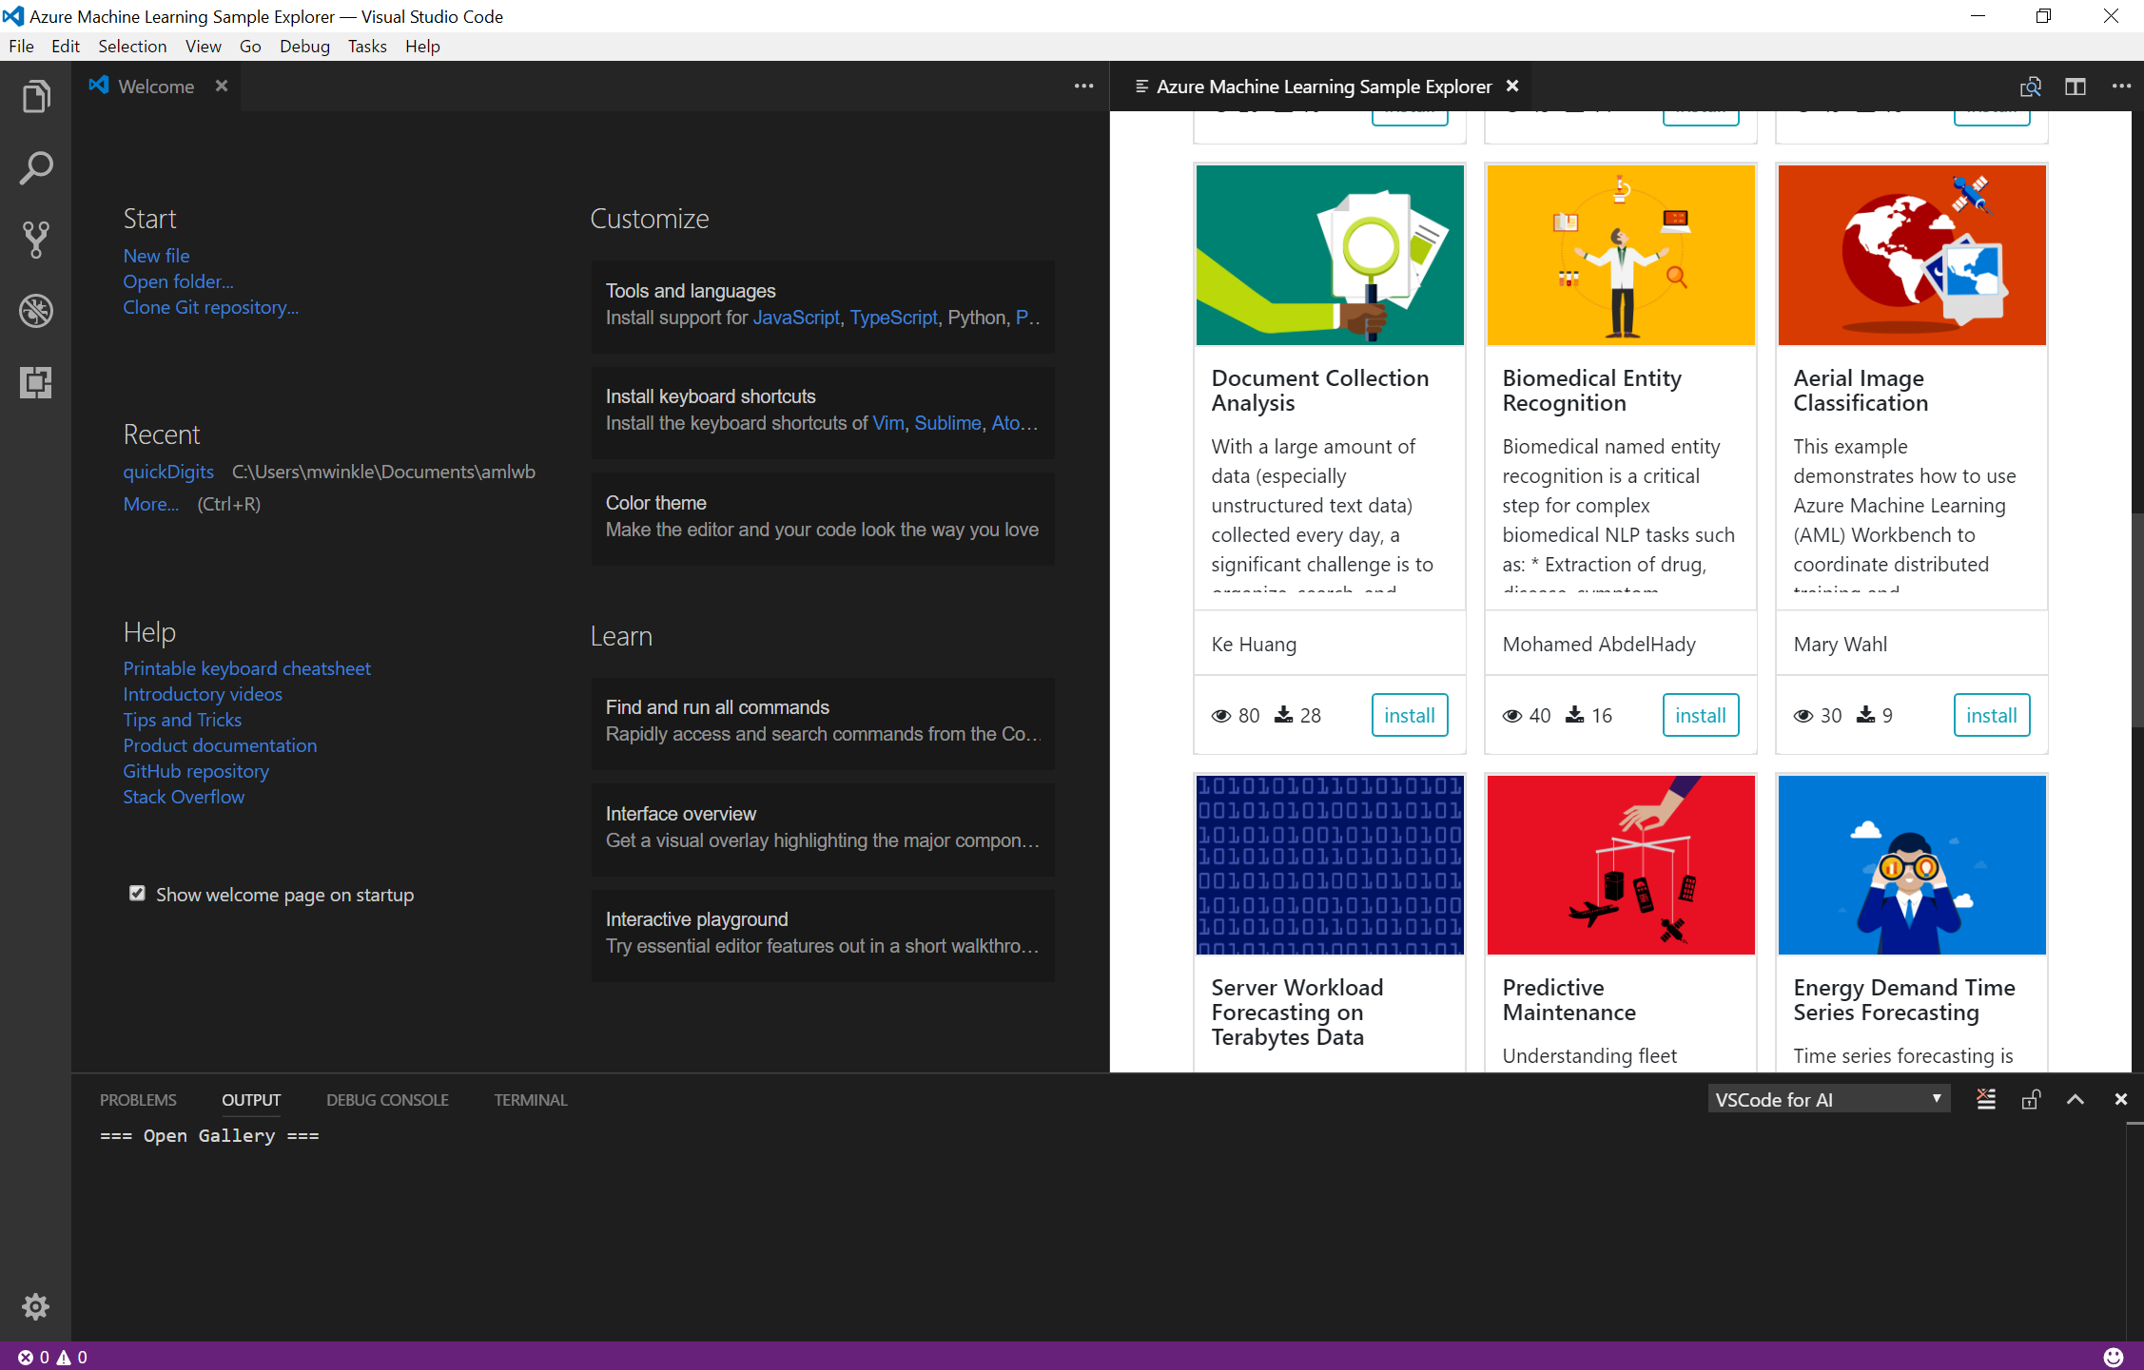
Visual Studio Tools for AI
Visual Studio extension with deep integration to Azure ML
End to end development environment, from new project through training
Support for remote training
Job management
On top of all of the goodness of Visual Studio (Python, Jupyter, Git, etc)
Notes:
Can go download and use this today. All goodness of VSCode, etc. is part of this

Slide 12
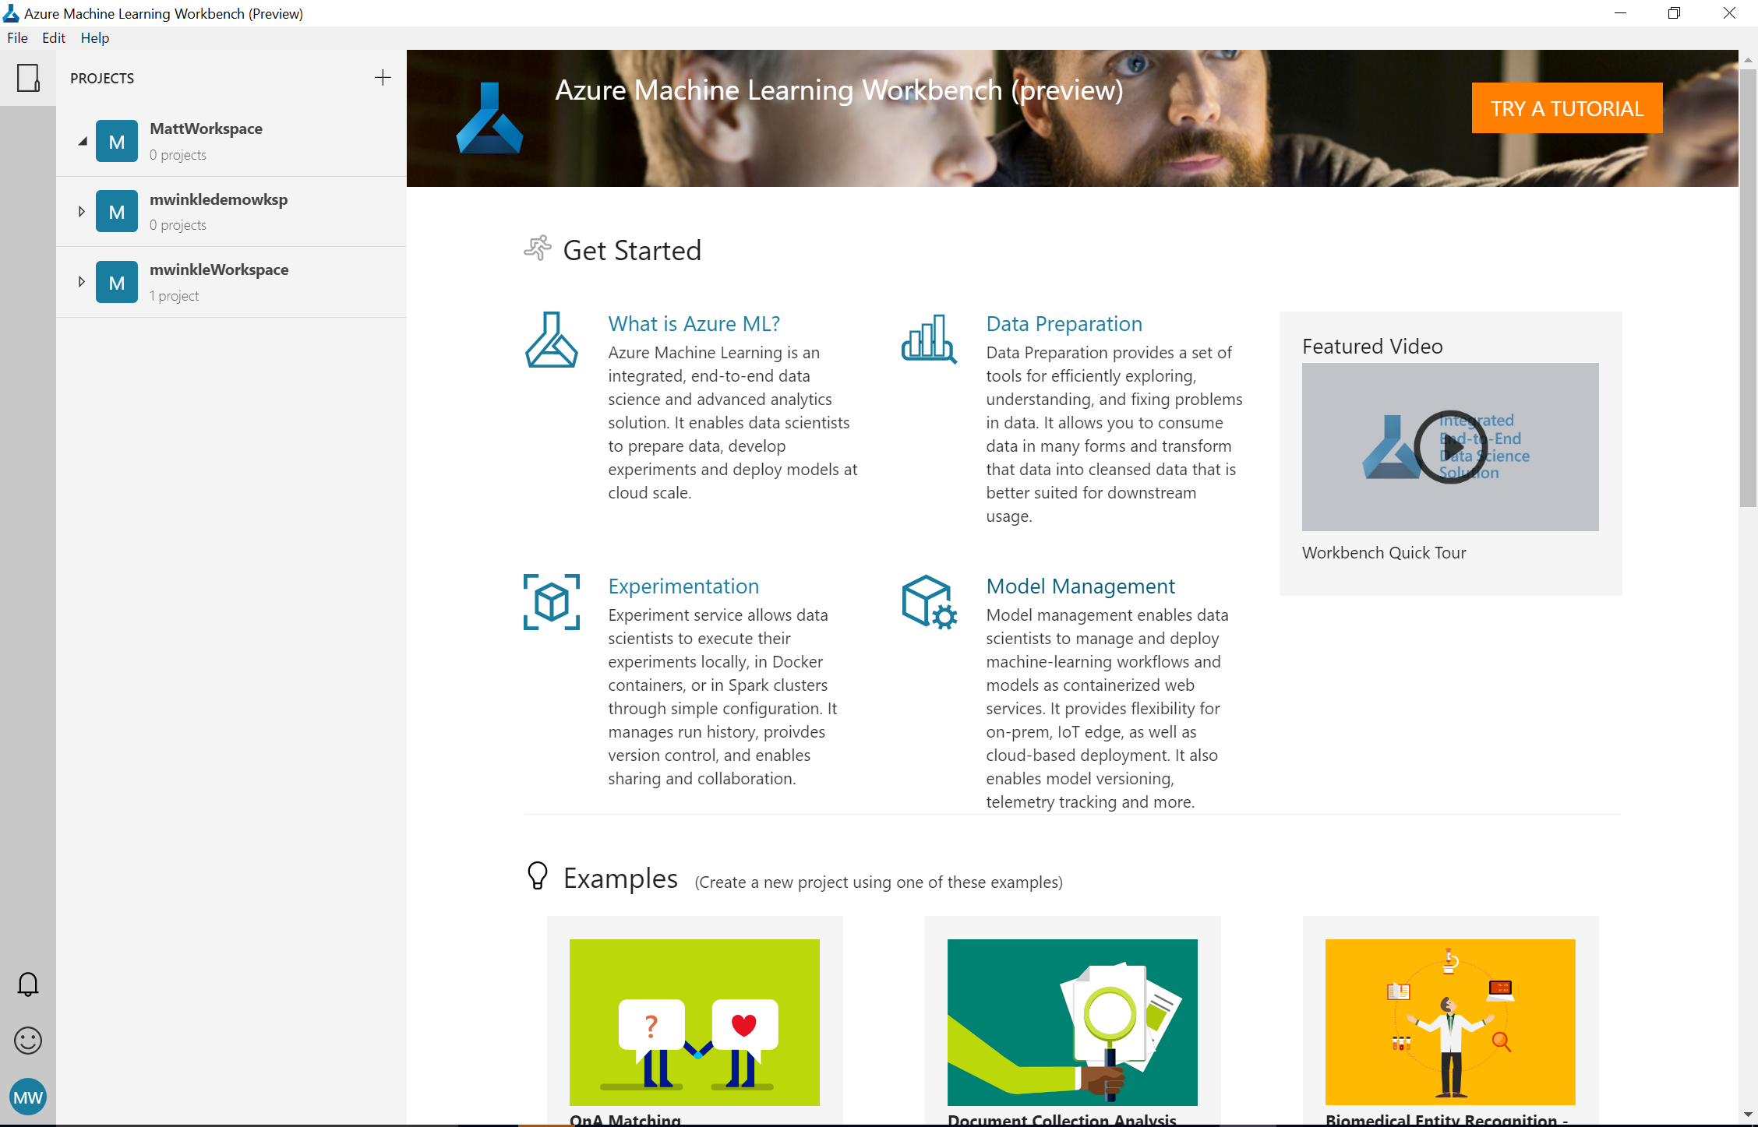
Azure Machine Learning Workbench
Windows and Mac based companion for AI development
Full environment set up (Python, Jupyter, etc)
Embedded notebooks
Run History and Comparison experience
New data wrangling tools

Slide 13
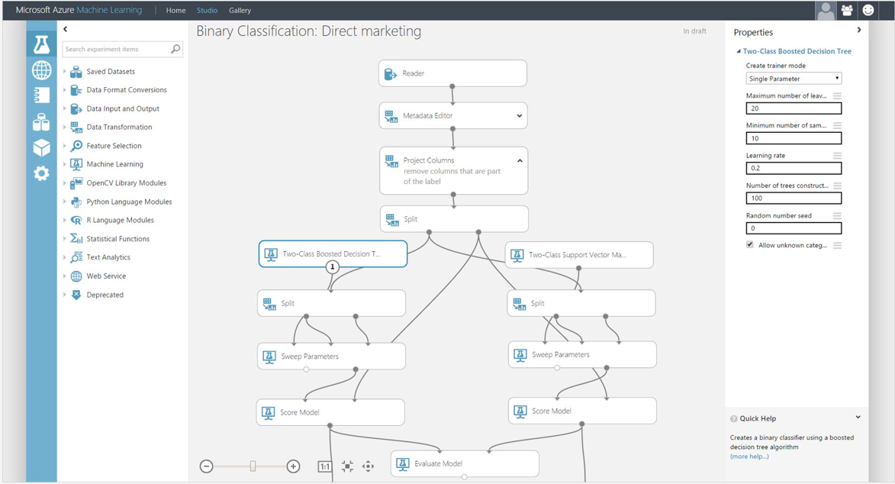
Azure Machine Learning Studio
Platform for emerging data scientists to graphically build and deploy experiments
Rapid experiment composition
> 100 easily configured modules for data prep, training, evaluation
Extensibility through R & Python
Serverless training and deployment
Some numbers:
100’s of thousands of deployed models serving billions of requests
Notes:
This is where we’re at today. AML is a platform that enables you to graphically compose a model. Serverless architecture.

Slide 14
Machine Learning & AI Portfolio When to use what?
Microsoft ML & AI products
Build your own or consume pre-trained models?
Build your own
Consume
Azure Machine Learning
Cognitive services, bots
Which experience do you want?
Code first
Visual tooling
Deployment target
(On-prem) ML Server
(cloud)
AML services (Preview)
(cloud)
AML Studio
What engine(s) do you want to use?
On-prem Hadoop
SQL Server
SQL Server
Spark
Hadoop
Azure Batch
DSVM
Azure Container Service

Slide 15
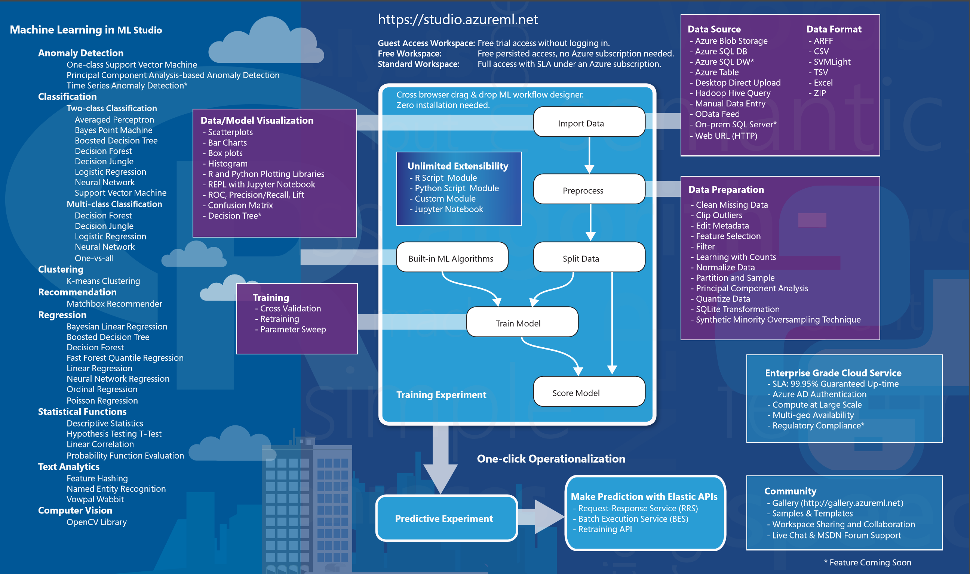
Azure Machine Learning Studio

Slide 16
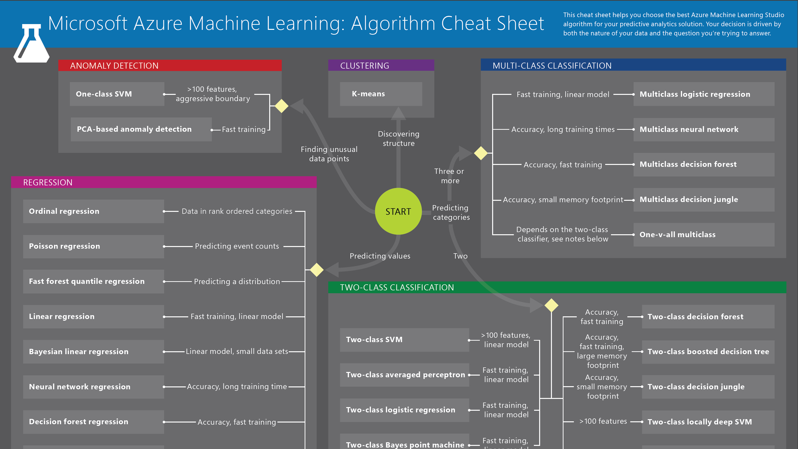

Slide 17
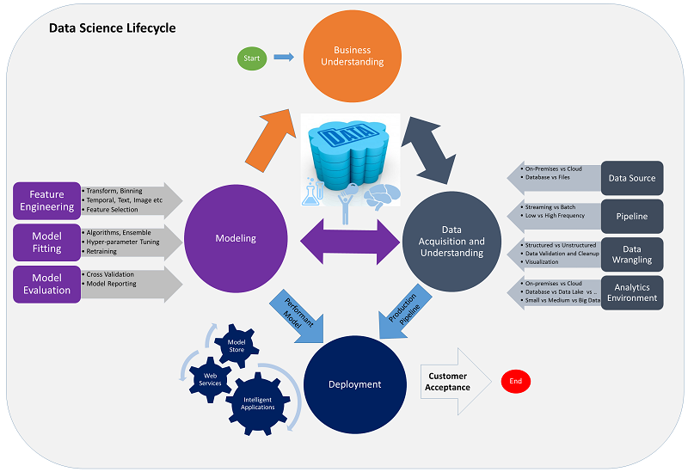
Data Science process – TDSP (Team Data Science Process)
Data Science Lifecycle
Business understanding
Data acquisition and understanding
Modeling
Deployment
Customer Acceptance

Slide 18
3. Modeling
Data Science process – TDSP
Model Training
Basic Machine Learning Elements
Import Data
Preprocess
Algorithm
Split Data
Train Model
Score Model

Slide 19
Https://aka.ms/mtcsmlstudio
ML Studio Demo

Slide 21
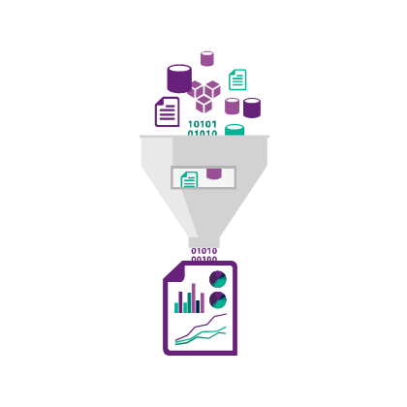
1. Business Understanding
Data Science process – TDSP
Analyze business needs
Define objectives
Identify key business variables
Project goal
Question
Success metrics
Identify data sources
Data sources that contain known examples of answers
Data characteristics
Data quality
Tools and language
Security
Encryption, Audit, Access control
Artifacts
Documents
Data sources
Data

Slide 22
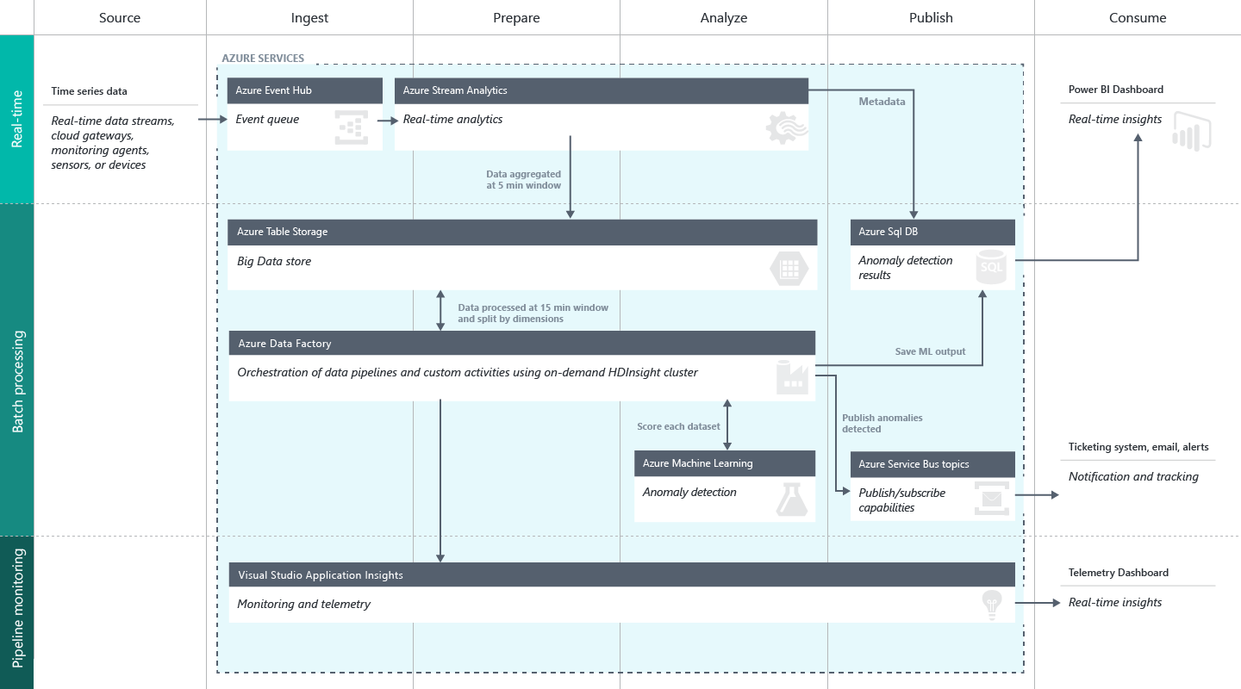
1. Business Understanding
Data Science process – TDSP
Solution Diagram

Slide 23
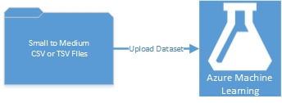
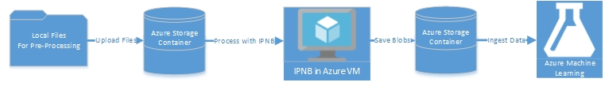
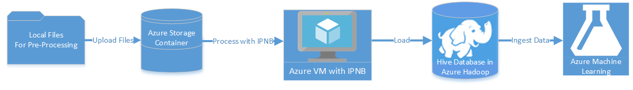
1. Business Understanding
Data Science process – TDSP
Solution Diagram
Scenario #1: Small to medium tabular dataset in a local files
Scenario #2: Small to medium dataset of local files that require processing
Scenario #3: Big data in local files, target Hive database in Azure HDInsight Hadoop clusters

Slide 24
2. Data Acquisition and Understanding
Data Science process – TDSP
Acquire and understand data
Ingest the data
Move the data from source to target location
Explore the data
Data cleaning
Incomplete
Noisy
Inconsistent
Audit the quality of data
Have better understand the patterns
Iterative works
Set up a data pipeline
Score new data
Refresh the data regularly
Pipeline may be batch-based or a streaming or hybrid
Artifacts
Data quality report
Solution architecture
Checkpoint decision

Slide 25
3. Modeling
Data Science process – TDSP
Develop models
Goals
Optimal data features for the machine learning model
Build informative machine learning model that predicts the target most accurately
Experiment for machine learning model that is suitable for production
How to do it
Feature engineering
Aggregate and transform the raw variables to create the features
Requires a creative combination of domain expertise and insights
Model training
How to choose algorithms
Split, Build, Evaluate, Determine the best solution
Artifacts
Feature sets
Modeling report
Checkpoint decision

Slide 26
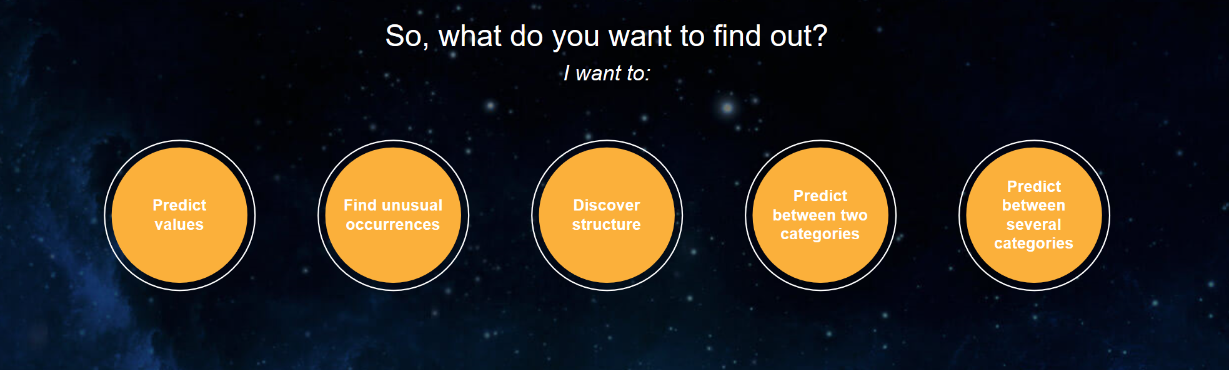
3. Modeling
Data Science process – TDSP
How to choose algorithms
https://azuremlsimpleds.azurewebsites.net/simpleds/

Slide 27
4. Deployment
Data Science process – TDSP
Operationalize models
Operationalize the model
Apply trained model to application for real-time or batch basis predictions
Expose the model as API interface to consume it easy
Artifacts
Status dashboard of system health and key metrics
Final modeling report with deployment details
Final solution architecture document

Slide 28
5. Customer Acceptance
Data Science process – TDSP
Finalize the project deliverables
System validation
Confirm the deployed model and pipeline are meeting customer needs
Monitor systems
Project hand-off
Artifacts
Project final report

